Slide 1
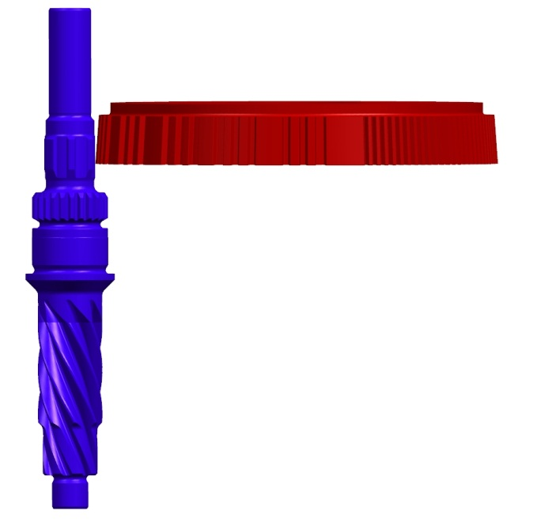
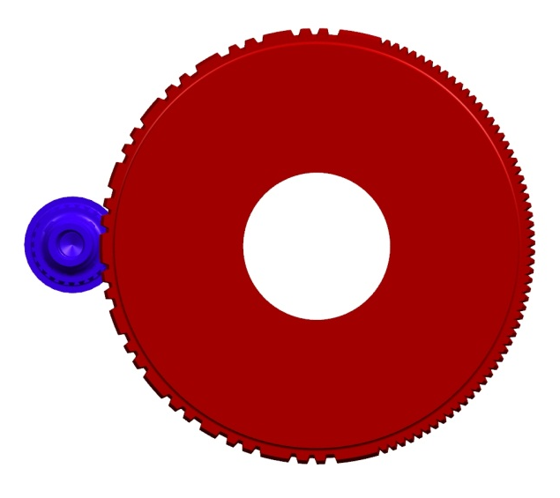
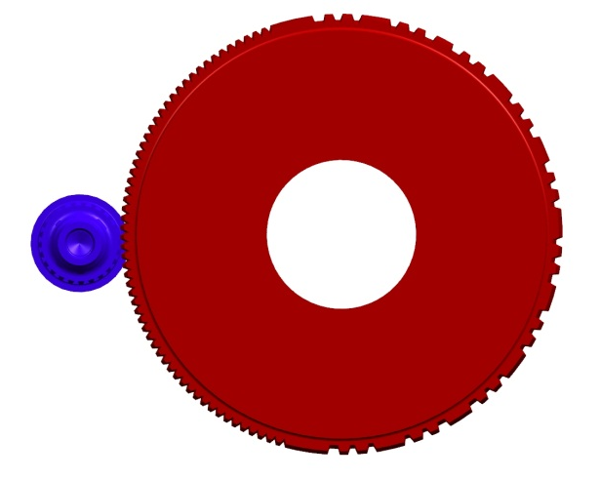
Stop Teeth – Sensor Spline Process improvements
Developing Single Shaping cutter to cut stop teeth and sensor spline in the same fixture.
Leads to dramatic improvement in true position and enables dramatic improvements in Hysteresis
Single Cutter
Stop Teeth
Sensor Spline

